Slide 1
Documentation work repartition
Plan

Slide 2
Content
General plan
Why
What
How
When

Slide 3
General Plan of the documentation
Overview
Geomatching
SDK
API
Portal

Slide 4
Why ? The developer path.
overview
Before diving into our documentation, users should be able to grasp the idea; the potential of Matchmore
Geomatching
When Matchmore is understood, developers want some quick codes they can copy-paste to try. Finally, they want a full explanation of everything
SDK
Help the developers to install our SDKs and start using our tools. Developers need to be aware of what the SDKs do for them
API
Display RESTFul API Doc
Portal
Managing their account is sometimes hard, explain clearly what they have access.

Slide 5
What ? The content in the section.
Overview
Geomatching
SDK
API
Portal
Matchmore
Example uses
Developer tools
Quickstart
How it works
iOS
Android
JavaScript
Unity 3D
React native ?
Xamarin ?
Dashboard
Apps
Beacons
Docs
Tools
Phomo?
What is my account for ?
Billing
Pricing
NEXT: SDK’s section content TO DO : Check difference in SDKs

Slide 6
What should contain a SDK section ?
Getting started (Installations, alternatives installations, example for ios: cocoapods, framework, carthage, source)
Configuration
Configure project (Request permission)
Add SDK to project
Start/stop Matchmore
Start/Stop location updates
For iOS/Android/React/Xamarin : Configure LocationManager
Foreground update locations
Background update locations
Manual update locations
Tutorials
Create a Mobile Device
Create a Pin Device
Create a Beacon Device (Except for SDKs that don’t support beacons yet)
Start/Stop Monitoring for device, APNS/FCM, WebSocket and Polling
Publish
Subscribe
GetMatches
Local States request (Create, Find, FindAll, Delete and DeleteAll)
Changelog
Supported Platform
Code examples Only

Slide 7
The language
We use american english. That is for example analyze and not analyse.
Date: May 23-24, 2018
Numbers: 1, 100, 10 000, 100 000. Not: 1’000 or 100000.
Startup not start-up
Events is broad; conference and exhibitions are smaller
The name on the company is Matchmore. The company name is Matchmore and is spelled Capitalized
When mentioned in the documentation and legal documents but is spelled lowercase in our logo. Some additional information such as Matchmore SA may be added when necessary.
The currently only product of our company is also called: matchmore in communication with our customers. Therefore, when relating to our product we should mention it as:
Matchmore cloud service
Or more precisely: Matchmore MBaaS cloud service, i.e. a Mobile Backend as a service cloud service.
Talking about components of our cloud service, we could mention a matchmore API, matchmore SDK, etc.
Vocabulary
“Geomatching” is our main component. You can also use “proximity detection” to describe geomatching
Use “Highly dynamic” when talking about two moving devices.
Matchmore is our product (Not ALPS).
Use object name as they are in the SDK or code. For example :
ViewController. Not view controller.
MatchDelegate, not match delegate.

Slide 8
Matrix supported features SDKs
SDK features | iOS | Android | JavaScript | Unity 3D | React | Xamarin
IOT Supported :
Mobile | ✅ | ✅ | ✅ | ✅ | ✅ | ✅
Pin | ✅ | ✅ | ✅ | ✅ | ✅ | ✅
Beacon | ✅ | ✅ | ❌ | ❌ | ❌ | ❌
Custom Location Mode :
Foreground Mode | ✅ | ✅ | ✅ | ✅ | ✅ | ✅
Background mode | ✅ | ✅ | ❌ | ✅ | ✅ | ✅
Terminated mode | ✅ | ❌ | ❌ | ✅ | ✅ | ✅
Getting Matches via :
Push notification (APNS, FCM) | ✅ | ✅ | ❌ | ✅ | ✅ | ✅
WebSocket | ✅ | ✅ | ✅ | ✅ | ✅ | ✅
Polling | ✅ | ✅ | ✅ | ✅ | ✅ | ✅
Caching of Data, locally store :
Device | ✅ | ✅ | ❌ | ✅ | ✅ | ✅
Pub/Sub | ✅ | ✅ | ❌ | ✅ | ✅ | ✅
Match | ✅ | ✅ | ❌ | ✅ | ✅ | ✅
Local states request :
Device | ✅ | ✅ | ❌ | ✅ | ✅ | ✅
Pub/sub | ✅ | ✅ | ❌ | ✅ | ✅ | ✅
Match | ✅ | ✅ | ❌ | ✅ | ✅ | ✅
Matchmore REST API : | ✅ | ✅ | ✅ | ✅ | ✅ | ✅

Slide 9
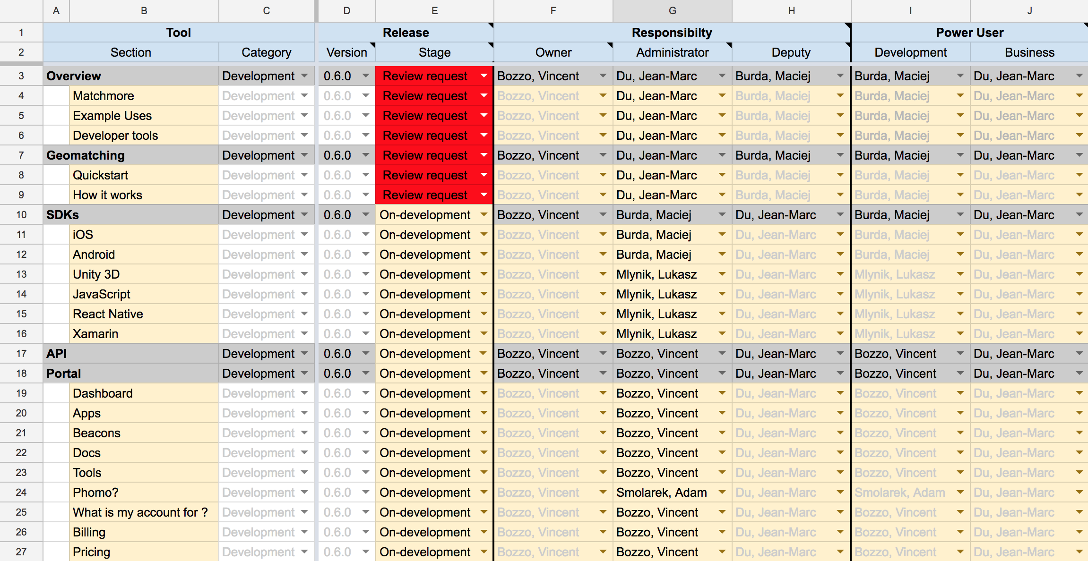
How ? Every Administrator is responsible to maintain their sections. Helps will come from their Deputy. More information available in : https://drive.google.com/open?id=1FhdFw8yWA4TGiAImq06J4mZ8nqFSY96jTnlqOs9PYpM

Slide 10
When ? Planning plan June – July 2018
2018 | 28 - 01.06 | 04 - 08 | 11 - 15 | 18 - 22 | 25 - 29 | 02.07 - 06 | 09 - 13 | 16 - 20 | 23 - 27 | 30 – 03.08
Integration
Writing
Reviewing
Production
Take FeedBack
Maintenance
1st June: Xamarin SDK
Writing
Review & correction
Production
Feedback from outside
Maintenance
POC MSO
Milestone 1
Integration of theme and template for documentation rendering
Milestone 2
Finished writing, we have a first version to rely on. Not perfect but enough.
Milestone 3 Correction are ready to be published on prod.
Milestone 4
Documentation is ready.
Milestone 5
We got a good idea of where we wants to head with our documentation

Slide 11
Thank you for your Contribution !

